Slide 1
An Introduction to Python
Day 2
Renaud Dessalles
_{dessalles@ucla.edu}

Slide 2
Data structures

Slide 3
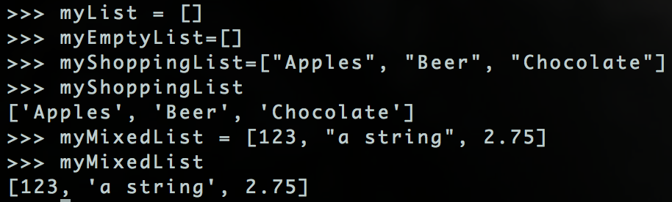
Python’s Data Structures - Lists
Lists can store lots of information.
The data doesn’t have to all be the same type! (unlike many other programing languages)
Notes:
Advanced features: object orientated

Slide 4
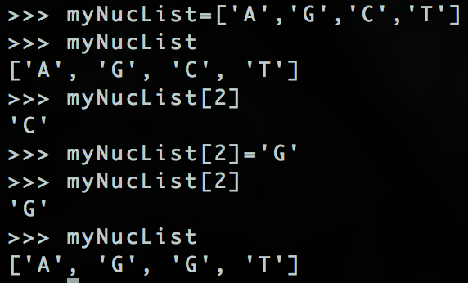
Python’s Data Structures – Lists 2
Can access and change elements of a list by index.
Starting at 0
myList[0]
Just like strings.
Notes:
Advanced features: object orientated

Slide 5
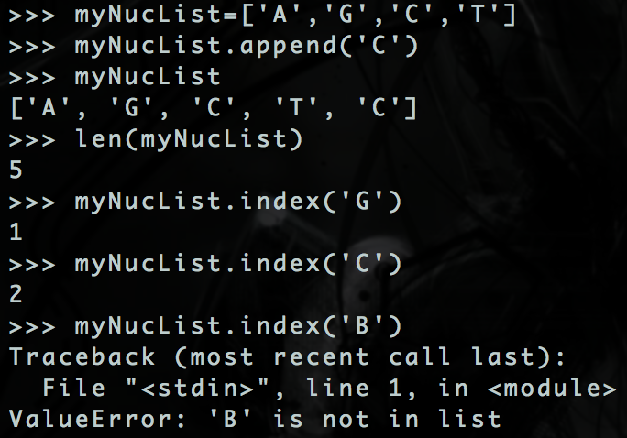
Python’s Data Structures – Lists 3
Lists have lots of handy functions.
myList.function(arguments)
Most are self explanatory.
Get an error if index() can’t find what it’s looking for.
Notes:
Advanced features: object orientated

Slide 6
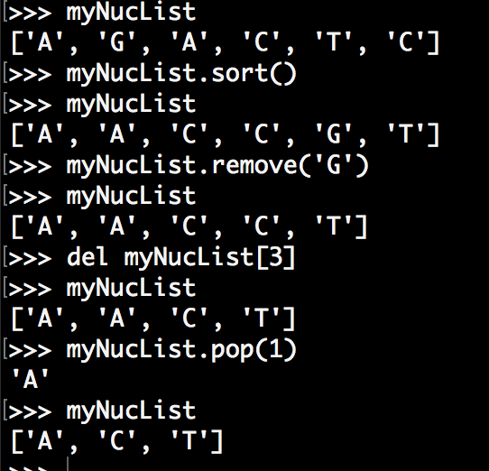
Python’s Data Structures – Lists 4
3 ways to delete
Notes:
Advanced features: object orientated

Slide 7
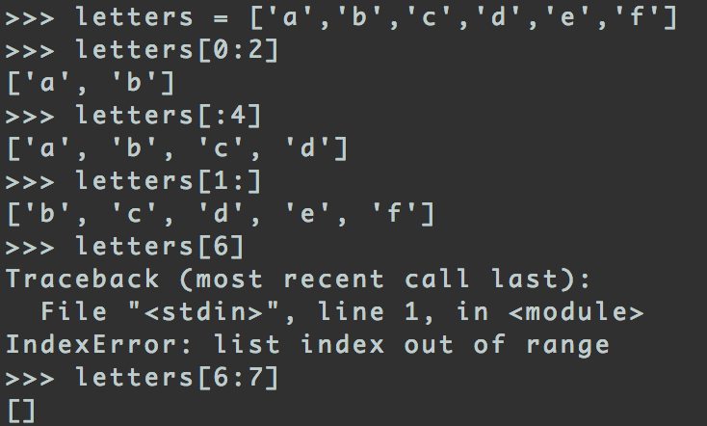
Python’s Data Structures – Lists 5
Notes:
Advanced features: object orientated

Slide 8
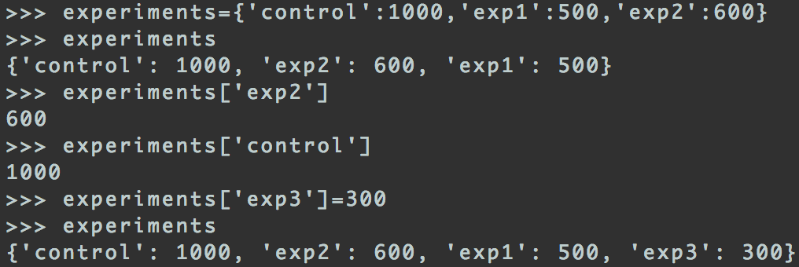
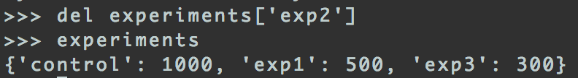
Python’s Data Structures – Dictionaries
Like lists, but have keys and values instead of index.
Keys are strings or numbers
Values are almost anything. E.g. Strings, lists, even another dictionary!
Notes:
Advanced features: object orientated

Slide 9
Scripts

Slide 10
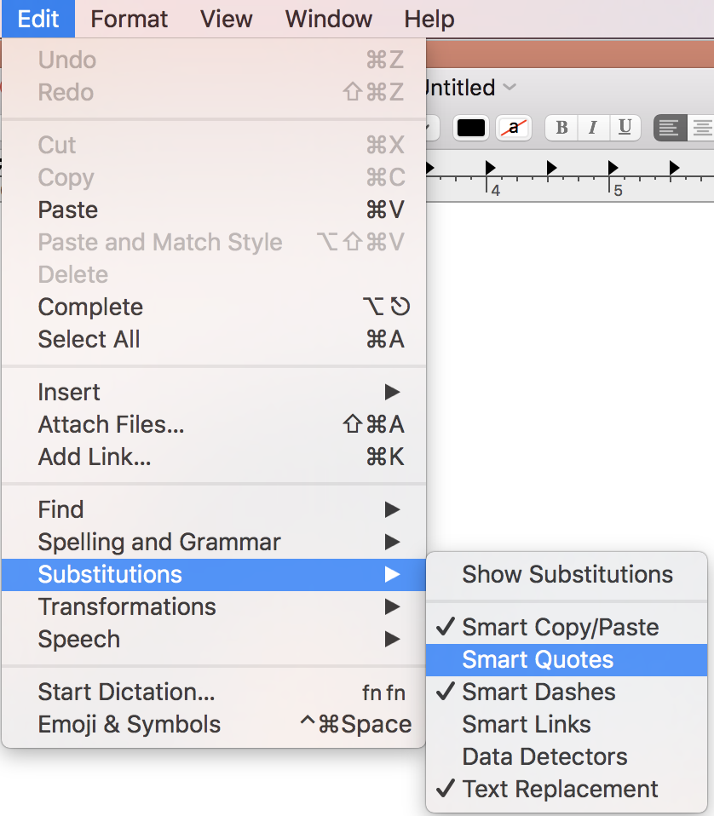
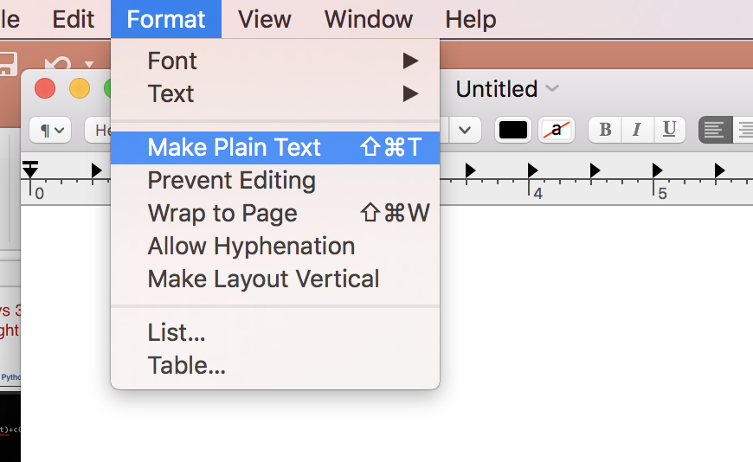
Reminder: writing in TextEdit (for Mac users)

Slide 11
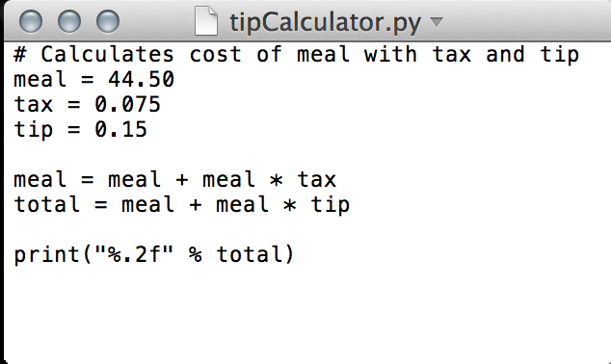
Example: Tip Calculator
First let’s figure out the pseudocode:
Set cost of meal
Set rate of tax
Set tip percentage
Calculate meal + tax
Calculate and return meal with tax + tip
Notes:
Advanced features: object orientated

Slide 12
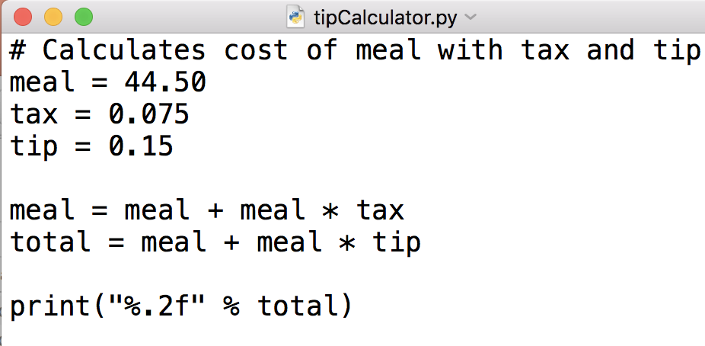
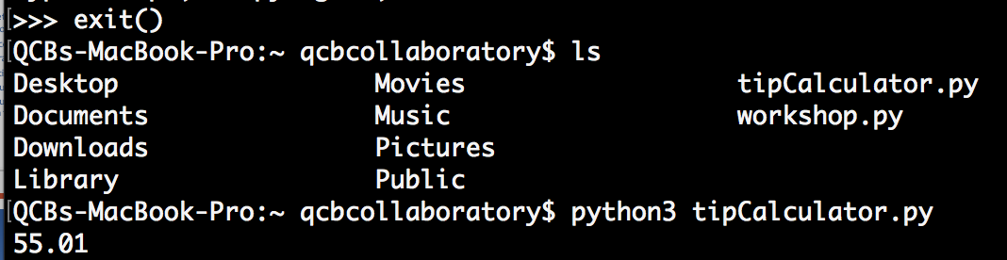
A Script Not a Module
Notes:
Advanced features: object orientated

Slide 13
Example: Tip Calculator 3
What if we want to calculate for a different meal cost without rewriting the code.
Pass the amount from the command line to python.
How do we get python to understand the new amount?
Need to import sys
sys.argv is a list of strings of parameters passed from the command line.
Notes:
Advanced features: object orientated

Slide 14
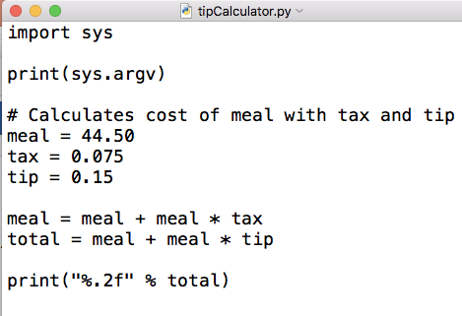
Handling Commandline Arguments
sys.argv[0] is tipCalculator.py
sys.argv[1] arg1…

Slide 15
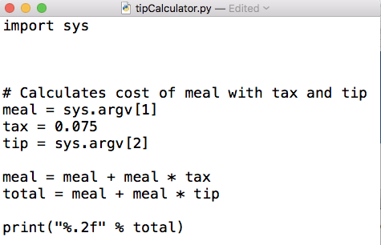
Handling Commandline Arguments 2

Slide 16
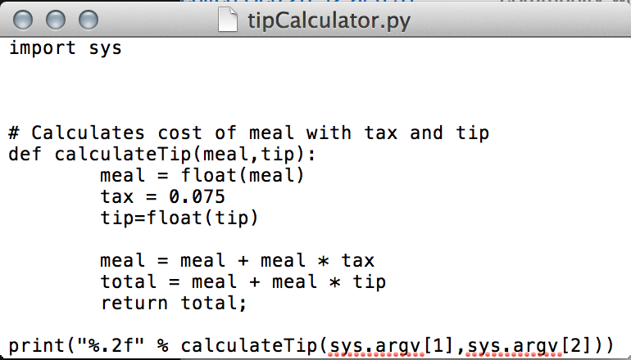
Handling Commandline Arguments 3
Make calculateTip a function. Useful if we need to reuse that code in future programs!
Command line arguments from sys.argv are always strings so cast to a float if we want to do maths with them.

Slide 17
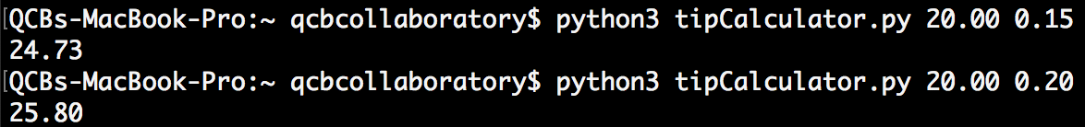
Test Your Tip Calculator

Slide 18
For loops

Slide 19
For Loops
Main program statements
For loop
If we want to perform the same tasks on every item in a list, string or dictionary we can use a FOR LOOP.
for variable in listName:
#any code here
for
Next item
Looping block
No more
item?
Continue main program

Slide 20
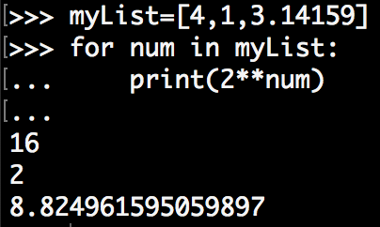
For Loops on a List
(Back in the python interactive environment)
for num in myList:
print 2^num

Slide 21
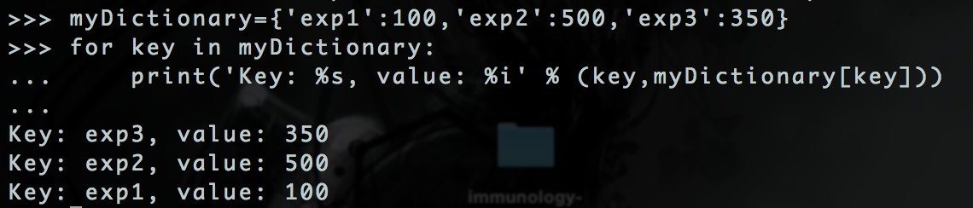
For Loops on a Dictionary
for key in myDictionary:
print key as a string and value as an integer

Slide 22
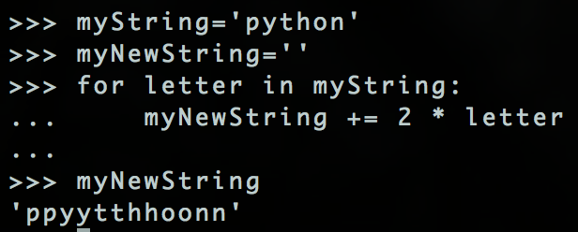
For Loops on a String
for letter in myString:
myNewString = myNewString + 2*letter

Slide 23
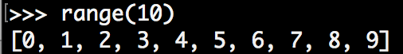
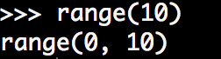
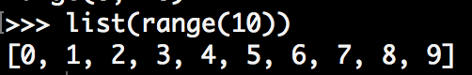
Python2 vs 3: Ranges
range(start,stop[,step])
Useful for looping over unusual ranges.
Python2
range returns a list
Use float on o\ne of the integers for a float division
Python3
range does not return a list
Can use list to see what it means
Same syntax for the for loops

Slide 24
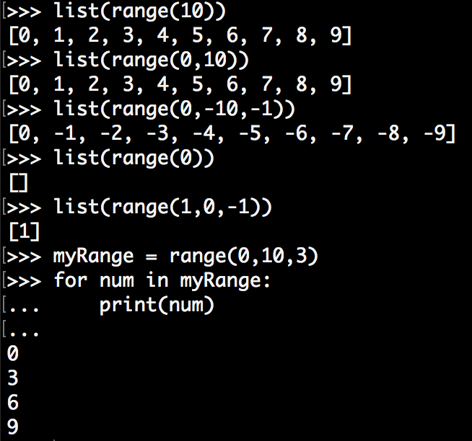
Ranges
range(start,stop[,step])
Useful for looping over unusual ranges.
Same syntax in Python2 and 3

Slide 25
A Function to Find the Complement
Make a function that takes a string of nucleotides and returns a string with the reverse complement. If the string contains a character that is not a nucleotide, print a message saying so.
Pseudocode:
for nucleotide in sequence
if nucleotide == ‘A’:
prepend complementSequence with ‘T’
else if nucleotide ==‘T’:
….

Slide 26
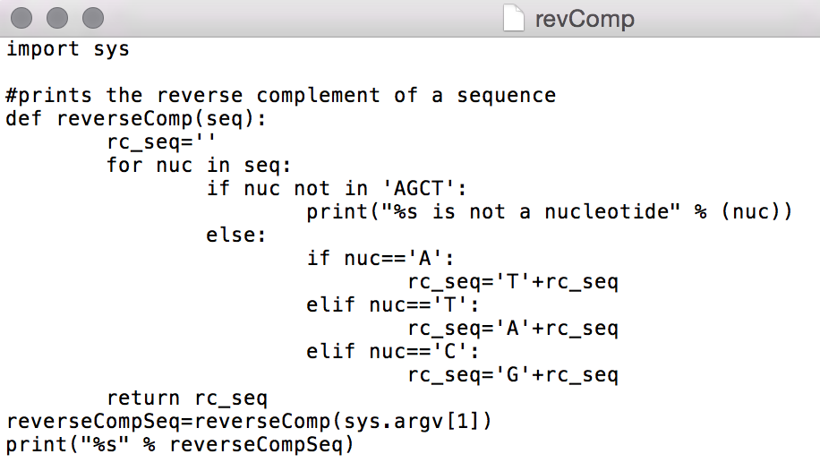
Reverse Complement 2
Import sys so we can get command line arguments
Make a function that takes a sequence as an argument

Slide 27
A Function to Find the Complement 3
Define a new empty string for the reverse complement
Use a for loop to do something for each nucleotide in the sequence
If one of the nucleotides isn’t AGCT the print a message and return nothing (quit the function without returning a new string).

Slide 28
A Function to Find the Complement 4
If the nuceotide is ‘A’, append T to our reverse complement string
Do the same for each nucleotide…

Slide 29
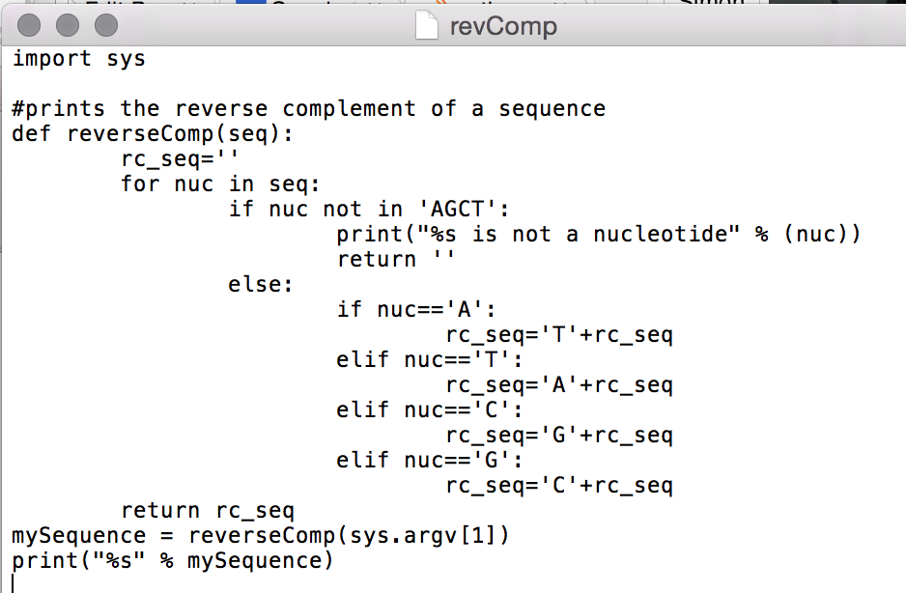
A Function to Find the Complement 5
The reverseComp function should return rc_seq string once the for loop has checked every nucleotide in the sequence.

Slide 30
A Function to Find the Complement 6
Run the script and print the output.
This should be the result of passing the first command line argument to our new reverseComp function.

Slide 31
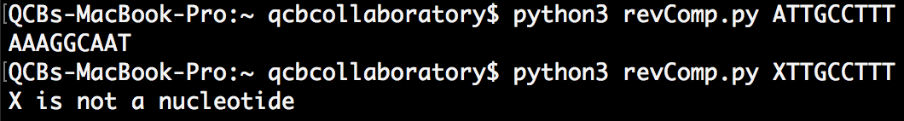
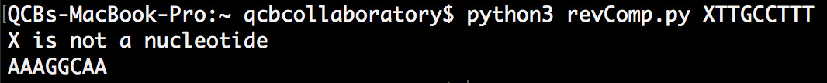
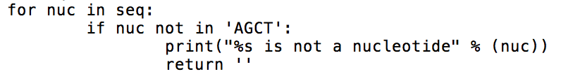
A Function to Find the Complement 7
Save it as revComp.py and let’s test it!
What does return '' used for?

Slide 32
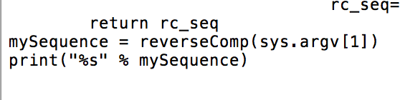
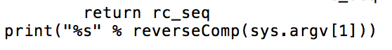
A Function to Find the Complement 8
Another improvement:
Run the function within the print statement!

Slide 33
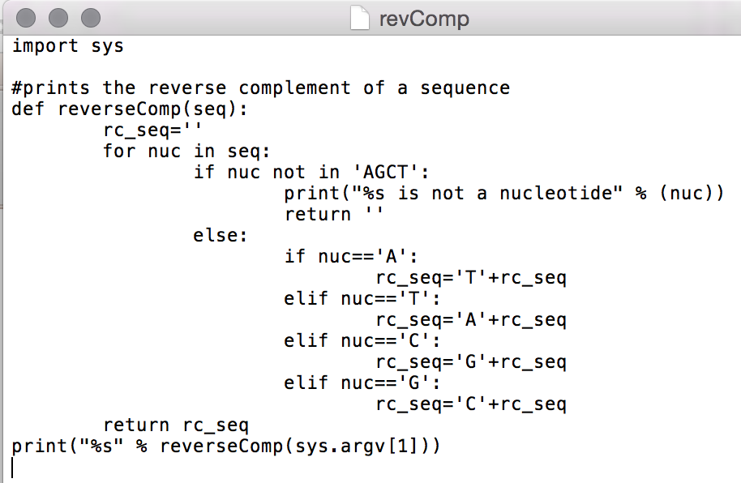
A Function to Find the Complement 9
Can we make better code than these if statements:
If
Elif
Elif
Elif

Slide 34
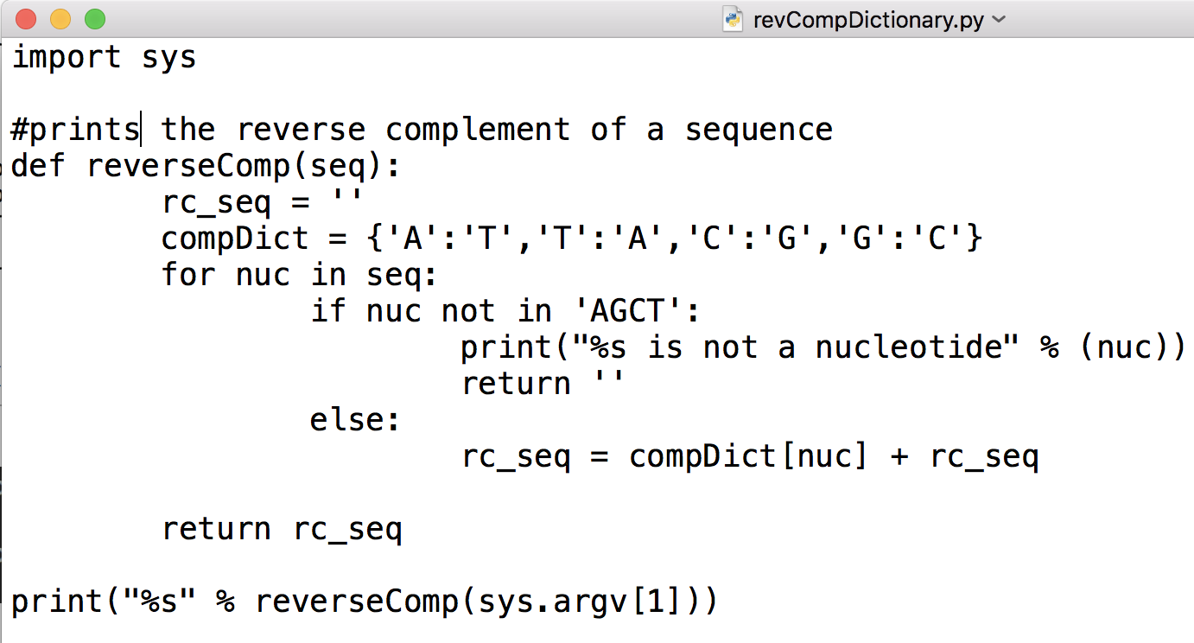
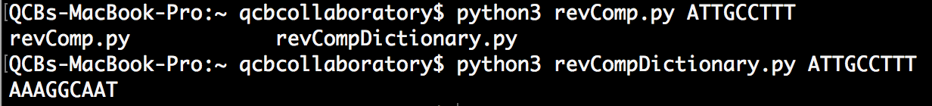
Dictionaries!
Works the same, much more elegant code!

Slide 35
More data structures

Slide 36
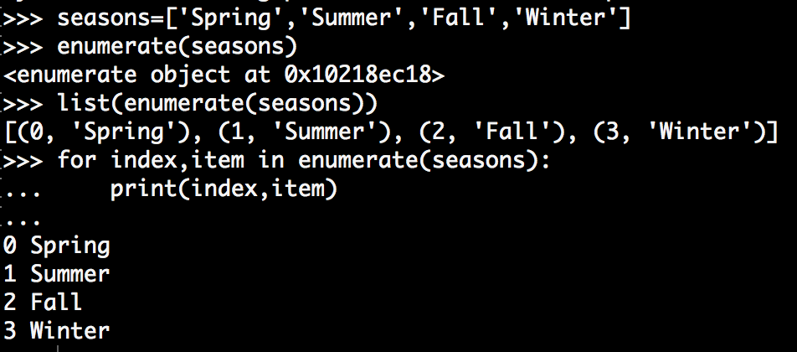
More Data Structures: Enumerate
Returns an ‘enumerate’ object which is the input with sequentially numbered inputs.

Slide 37
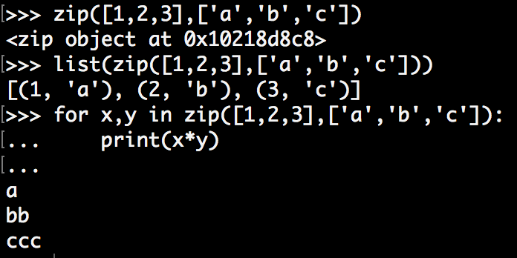
Zip
“Zips together” two lists

Slide 38
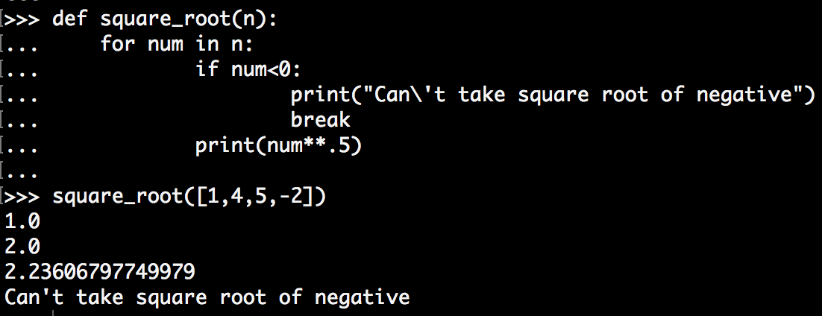
Break statements
Exit the loop they are in. Notice the output isn’t printed for the negative number:

Slide 39
While loops

Slide 40
While loops
Keeps executing the code in the loop while the condition remains true.
Rechecks the condition after each iteration.
while condition:
#code to execute
while
True
False

Slide 41
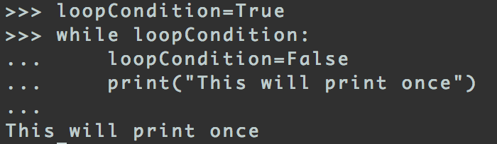
While loops
Set loopCondition to True.
While loop checks if loopCondition is true.
It is, so the code inside the loop will be executed next.

Slide 42
While loops
Set loopCondition to False.
The while loop doesn’t recheck the loopCondition until it reaches the end so the code will continue executing.

Slide 43
While loops
Print “this will print once”.
We are at the end of the loop now so the loopCondition will be checked next.

Slide 44
While loops
loopCondition is False now so the code inside the loop will not be executed.

Slide 45
While loops
Indeed the text is printed just once!

Slide 46
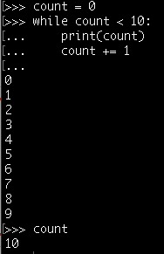
While loops
Don’t forget to include the count+=1 else you create an infinite loop!
Why does it print 9 last yet
count = 10 after the code is finished?
How do we get it to print all the way to 10?

Slide 47
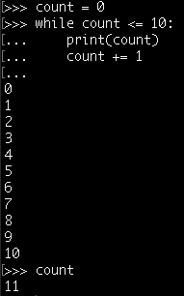
While loops
Switching order of count and print statements is one way!
Could also have made condition:
While count <=10

Slide 48
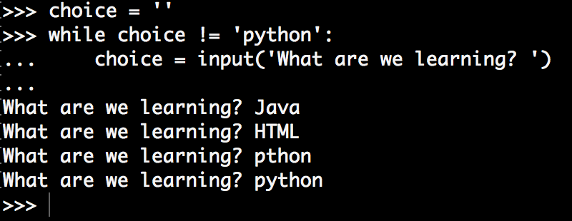
While loops
Keep doing a loop until the correct input is received:
Reminder: in Python2, it should be raw_input

Slide 49
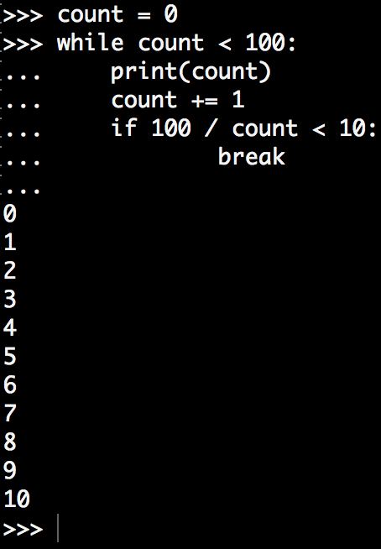
Break statements can exit while loops
The while loop condition is never met but the code reaches a break before count reaches 100.

Slide 50
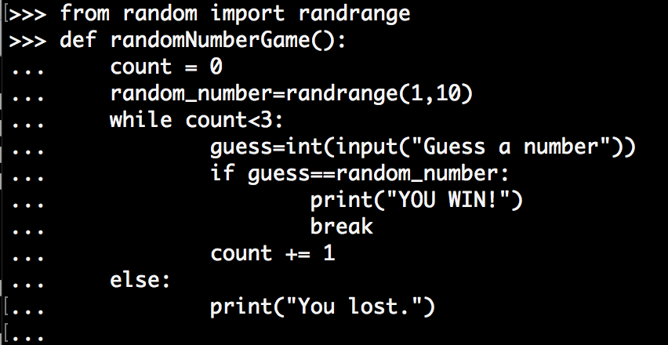
While / Else
Else: only executed if while loop finishes without reaching a break.

Slide 51
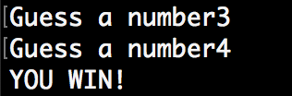
Play the random number game!

Slide 52
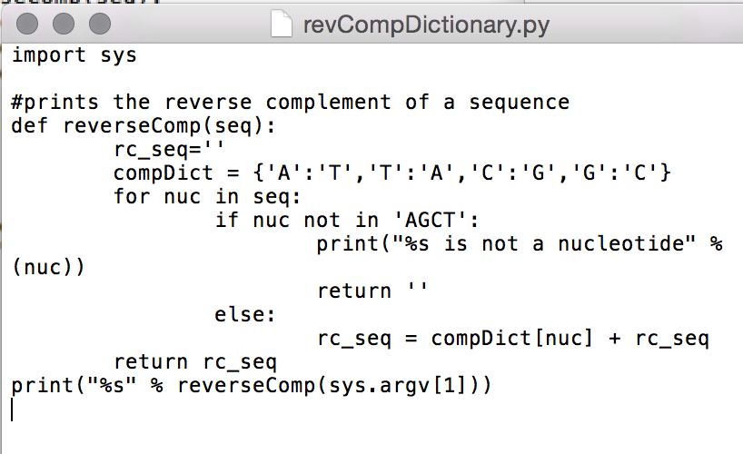
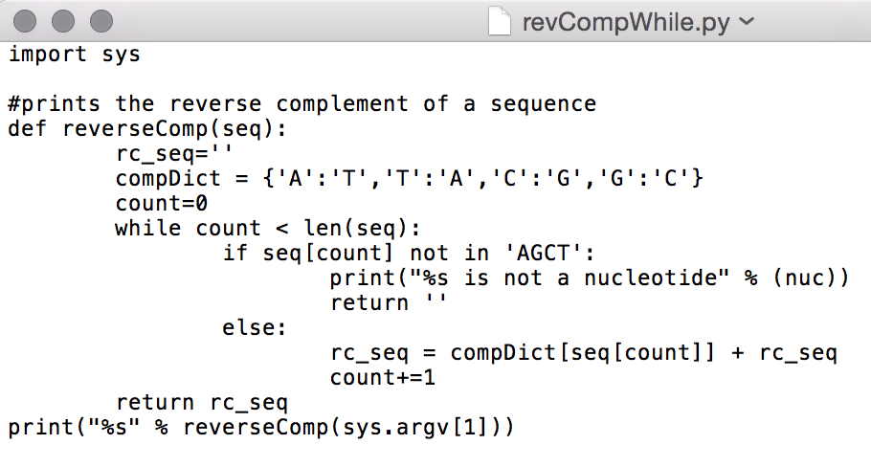
Reverse Complement Returns

Slide 53
Errors and exceptions

Slide 54
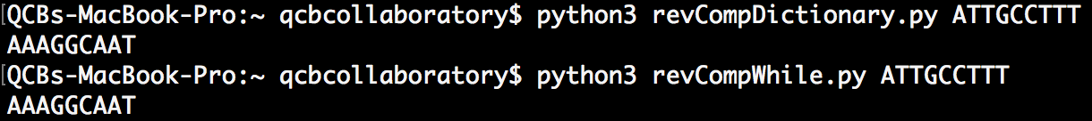
Errors
Everyone gets errors in their code. You may already have had some!
Knowing what the errors mean help you fix them. Errors messages are quite informative even if they seem difficult to understand

Slide 55
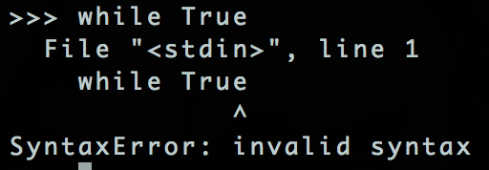
Syntax Error
Notice the error highlighting which part of the code is incorrect.
Syntax errors are the most generic and common. To fix, check the line in the error message, specifically check around the arrow. What is wrong with the first line above?

Slide 56
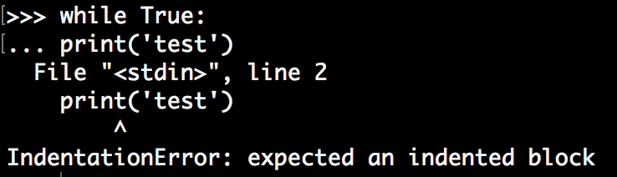
Indentation Error
We’ve fixed the while True: line.
Indentation error is a specific type of syntax error which tells you your code was not correctly indented.
How do we correct this code?

Slide 57
Exceptions
Sometimes code will be valid and won’t cause an error while you input it but can error when it is executed.
Errors that occur at the time code runs are called exceptions.
Not all exceptions are fatal, you can include code to handle exceptions.

Slide 58
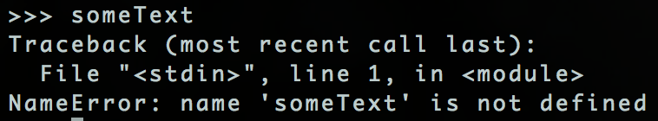
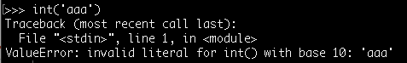


Exceptions
Name error
Value error
Divide by zero error
Keyboard interrupt (ctrl+c)

Slide 59


Exceptions
Type error
Input object error
Let’s figure out how to handle these exceptions…

Slide 60

Handling Exceptions
We can see that this code throws a ValueError.
If we don’t want this to stop the program, or we want to show a more helpful error message then we need to add some code:

Slide 61

Handling Exceptions
The try section is executed first.
If a number is received, then no exception will be thrown so the break command will be reached

Slide 62
Handling Exceptions
If no error types are matched the code will throw an unformatted exception as if the try and except commands were not there.

Slide 63

Handling Exceptions
Can have multiple exceptions handled by the same section.
Have an else clause that runs if the try ends without a break command.

Slide 64

Exception Hierarchy
If you handle a class it will handle all subclasses, so consider that if you catch StandardError it will be difficult to write code to handle all possible exceptions. Try and handle as low level exception as possible and avoid:
except Exception

